Slide 1
ECA Tips
Part 1
Writing Prompt

Slide 2
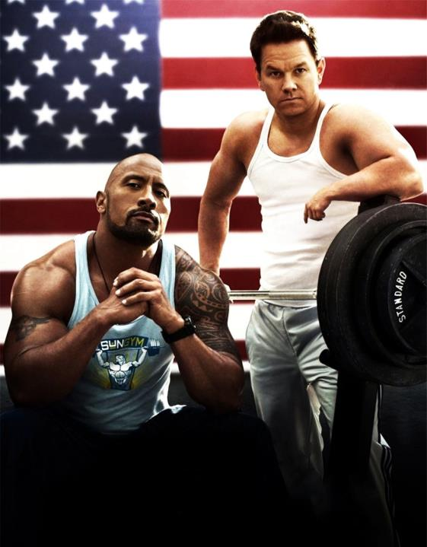
Basic Rules
Write five + paragraphs.
Each paragraph should contain five + sentences. 25 sentences – not hard.
Check capitalization, spelling, commas, and punctuation. Indent every paragraph!

Slide 3
Basic Format of an Essay
1^{st ¶}: Introduce topic, answer
quote and/or prompt, give
thesis
2nd ¶: Evidence/Reason 1. State reason then explain reason
3rd ¶: Repeat step 2
4th ¶: Repeat again (as many
times as you can)
Last ¶: Conclusion. Sum up
points. Tell audience why they
should care, restate thesis

Slide 4
Example Prompt
Mark Twain once said, “One lie is enough to question all truths.” Do you agree? Is it ever okay to lie to someone? Describe a time that you lied and tell what the outcome was.

Slide 5
Mark Twain once said, “One lie is enough to question all truths.” Do you agree? Is it ever okay to lie to someone? Describe a time that you lied and what the outcome was.
First: Identify all parts of the prompt you
need to answer. Highlight
everything the prompt tells
you to do or asks. That way
you can make sure you have
answered the prompt
completely.

Slide 6
Second – Determine what you’re going to argue. Are you for or against lying? Your personal opinion does not matter. Argue whatever side you can come up with more reasons for. Write your reasons down so you will remember them!
Reasons to lie:
-Save someone’s
feelings
-Not get in
trouble
Reasons not to lie:
-Might forget the lie
-They might find out
-Might make things
worse
-Might lose someone’s
trust
For this paper I have decided I will agree that lying is bad – I have more reasons (which equals more paragraphs) to write about not lying.

Slide 7
Third: The narrative doesn’t have to be truthful. Make up a story that fits your thesis if you need.
I might tell about a time that I lied to a friend about being able to hang out. I told her I wasn’t feeling well, but really I wanted to go to the mall with a different friend. Guess what happened? She saw me there and got mad. She had a hard time trusting me after that and I lost a friend. Worse, she told my other friends what I did and now they don’t trust me. Boy, I sure learned my lesson, didn’t I? And doesn’t this story prove my thesis?

Slide 8
Ms. T., I suck at introductions.
Start by introducing your topic. If the prompt started with a quote, there’s no reason you can’t.
Think of an introduction like a funnel. We start vague, then narrow it down to what we are specifically going to prove (football, football safety, helmet regulations, helmet regulations aren’t good enough).

Slide 9
Check out this example:
Mark Twain once said that one lie is enough for someone to question all truths. Nobody enjoys being lied to; in fact, most people usually avoid being friends with people who do not tell the truth. Even a lie that is told with the best of intentions can backfire. A lie can destroy relationships, ruin careers, or create dangerous situations. The risks involved with telling lies are never equal to the rewards.
Notice – I’ve let the audience know what I’m talking about (lying). I’ve answered the prompt’s question about the quote, and I’ve let my reader know what I’m going to be proving (lying causes more problems than it solves).

Slide 10
So what next?
Personally, I would tell my
narrative in the next (2nd)
paragraph. In the 3rd
paragraph I would describe
the outcome and what I
learned (lost a friend, wasn’t
worth it. Lies can ruin
relationships). In the 4th paragraph I would describe the
ways lies could ruin someone’s career. I would make a 5th
paragraph about lies creating dangerous situations (lying
about curfew maybe? doing illegal things?) Then I’d
conclude in my sixth paragraph.

Slide 11
One last time…
At least five paragraphs
Highlight the things in the prompt that you must answer
Choose one side to argue
Introduce your topic and set up your thesis in the introduction
One paragraph for a narrative
One paragraph for each reason
(at least three)
One paragraph for
a conclusion
Good luck!

